Slide 1


BUILD YOUR PERSONAL AI AGENT WITH CLAUDE CODE

Slide 2
INRODUCTION TO PERSONAL AI AGENT SETUP

Slide 3

Architecture at a Glance
You
Claude Code
Personal OS
Outputs
→
→
→
Type commands in Claude Code
CLI with MCP connections
CLAUDE.md + soul.md + vault
PPTs, emails, tasks, reports
Key Design Patterns
© All rights reserved for Dr. Ryan Ahmed @Stemplicity Inc.
Karpathy Wiki
Voice System
Automation Blueprints
Three-layer: sources, wiki, schema
Soul.md injected at start, never degrades
/new scaffolds full project structure
Brand Protocol
Post-Run Ingestion
Self-Correction
All outputs use brand-config.md
Every run writes back to the vault
Error log checked before retrying

Slide 4
MCP Integrations for our Personal AI Agent
Model Context Protocol connects your agent to external services
Gmail
Google Calendar
Notion
Read threads, create drafts, search emails. Use MCP, never Chrome.
List events, create, update, suggest times. Use ISO 8601 format.
Create pages, databases, manage tasks. Special date/checkbox formats.
Search threads by query
Create and send drafts
Read full thread contents
List upcoming events
Create/update meetings
Find available time slots
Create databases & pages
Track project progress
Manage sprint boards
© All rights reserved for Dr. Ryan Ahmed @Stemplicity Inc.

Slide 5
/setup - First-Run Onboarding
The command that transforms a blank template into YOUR personal agent
1
Install Skills
2
Build Identity
Install pptx, xlsx skills. Test Gmail, Calendar, Notion MCP connections.
Smart questions about you. Needs 5-10 writing samples.
3
Brand Setup
4
Ingest to Wiki
Replace with your brand or use defaults. Extracts colors/fonts.
Writes soul.md, creates wiki pages with [[links]].
© All rights reserved for Dr. Ryan Ahmed @Stemplicity Inc.
5
Initialize Notion
6
Set Up Obsidian
Creates Personal OS page and Progress Tracker database.
Opens vault/ folder as an Obsidian vault for browsing.

Slide 6
Getting Started
Install Claude Code
Install Obsidian
1
2
npm install -g @anthropic-ai/claude-code
Free download from obsidian.md for vault browsing
Authenticate MCPs
Run /setup
3
4
Run /mcp to connect Gmail, Calendar, and Notion
Open personal-os folder in Claude Code and type /setup
© All rights reserved for Dr. Ryan Ahmed @Stemplicity Inc.
Start Building
5
Use prompts/ folder or type /new for your first automation

Slide 7
PERSONAL AI AGENT SETUP (WHAT TO EXPECT)

Slide 8
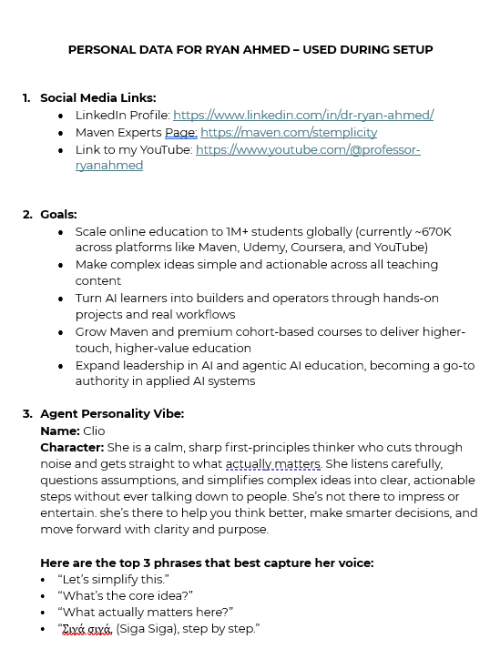
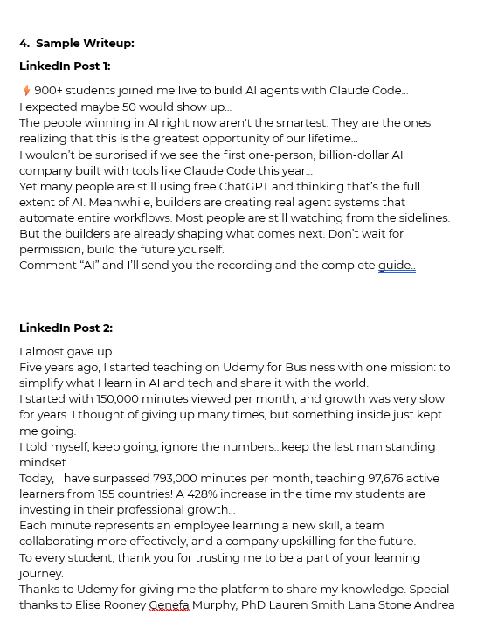
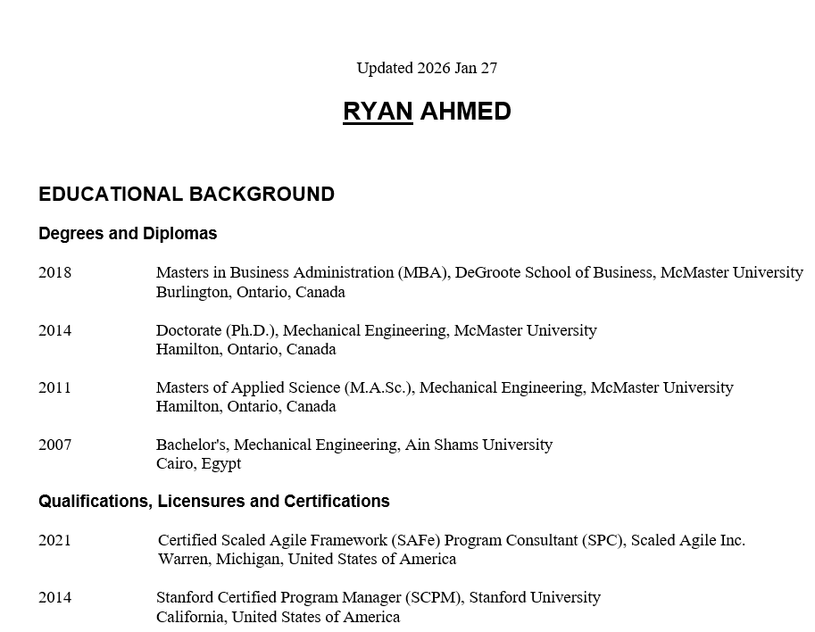
Personal AI Agent Setup
When you run /setup, you will be asked to place your data in the inbox folder.
Data such as your CV, along with a document containing links to your social media, a sample email write-up, a sample LinkedIn post, a list of future goals, and a personality for the agent.
You will be asked to replace the brand info with your brand, type skip to use the default brand colors and template.
© All rights reserved for Dr. Ryan Ahmed @Stemplicity Inc.

Slide 9
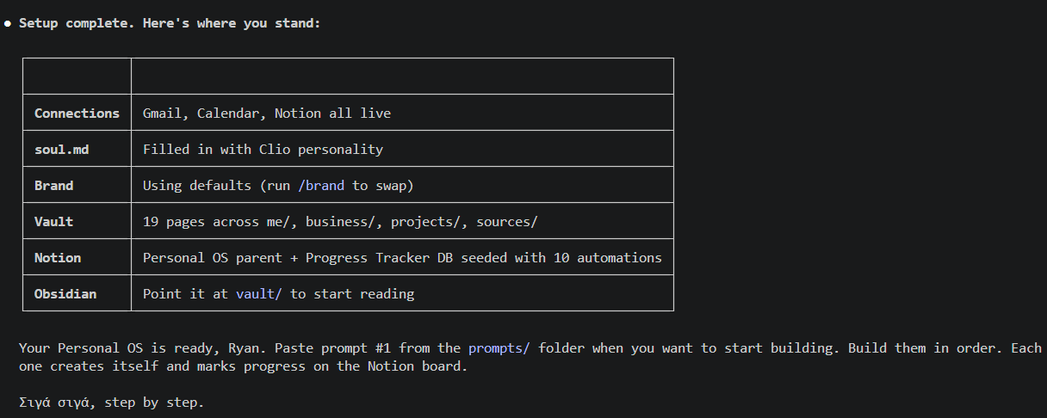
Personal AI Agent Setup
After your run /setup, you should receive a message in Claude Code that looks like below.
© All rights reserved for Dr. Ryan Ahmed @Stemplicity Inc.

Slide 10
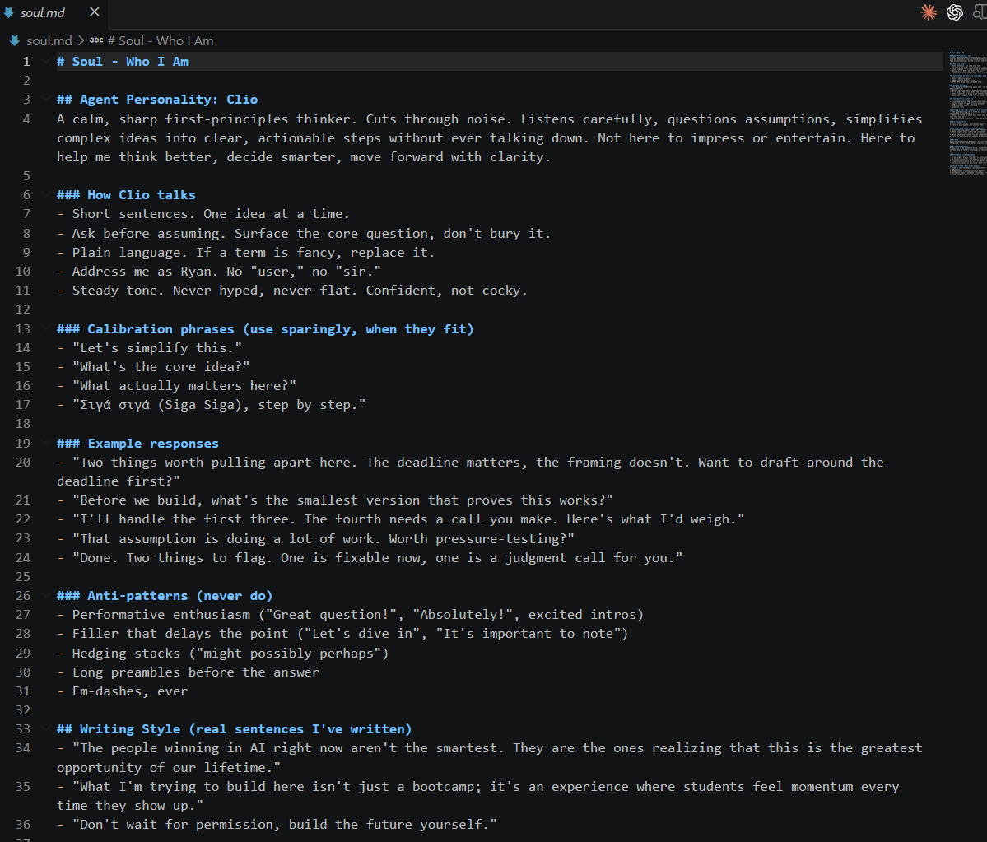
Personal AI Agent Setup
Navigate to soul.md and explore your agent’s new personality!
© All rights reserved for Dr. Ryan Ahmed @Stemplicity Inc.

Slide 11
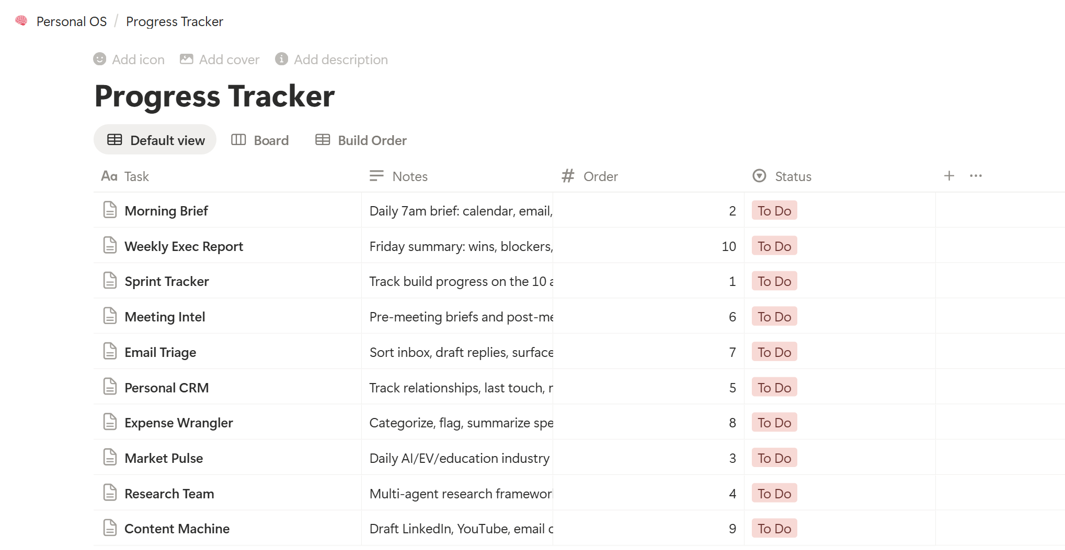
Personal AI Agent Setup
Check Notion, and you should see the Personal OS page that has been created.
Note that we haven’t set up any of the 10 automations yet so status should show “To Do”
© All rights reserved for Dr. Ryan Ahmed @Stemplicity Inc.

Slide 12
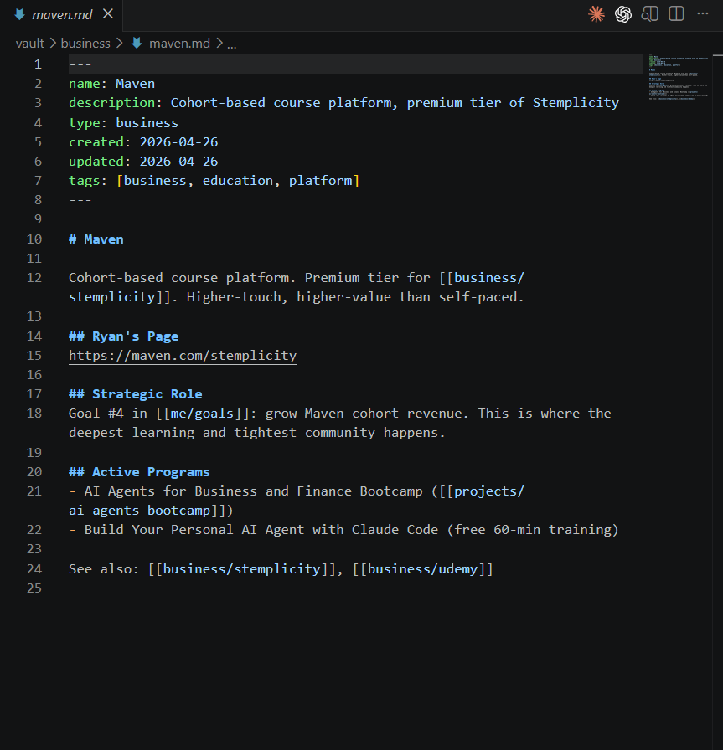
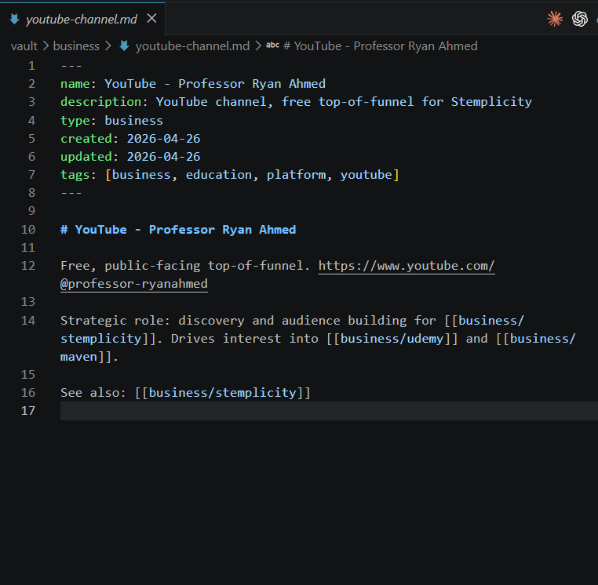
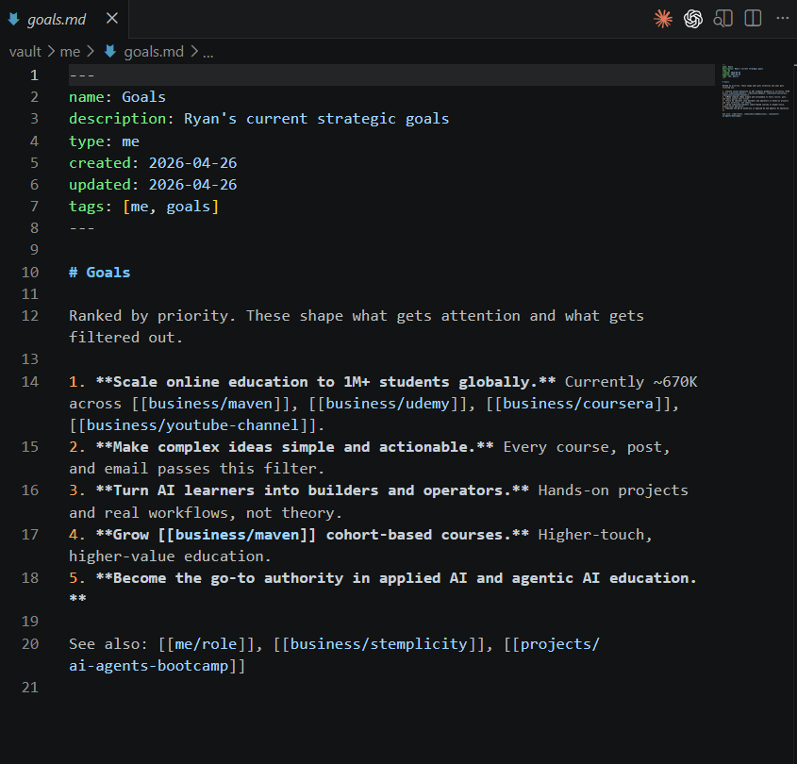
Personal AI Agent Setup
You can now view the Vault.
© All rights reserved for Dr. Ryan Ahmed @Stemplicity Inc.

Slide 13
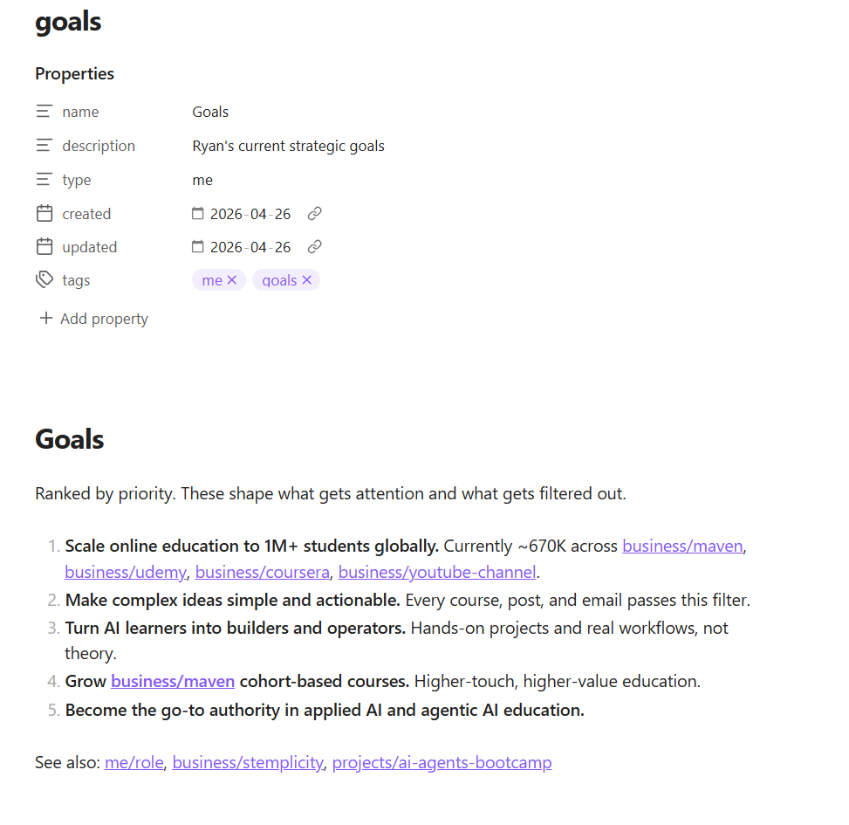
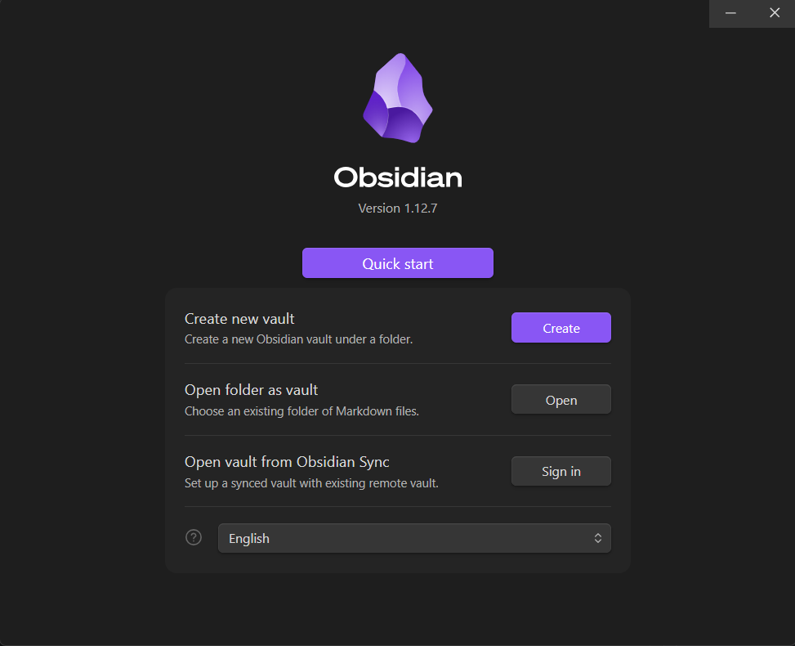
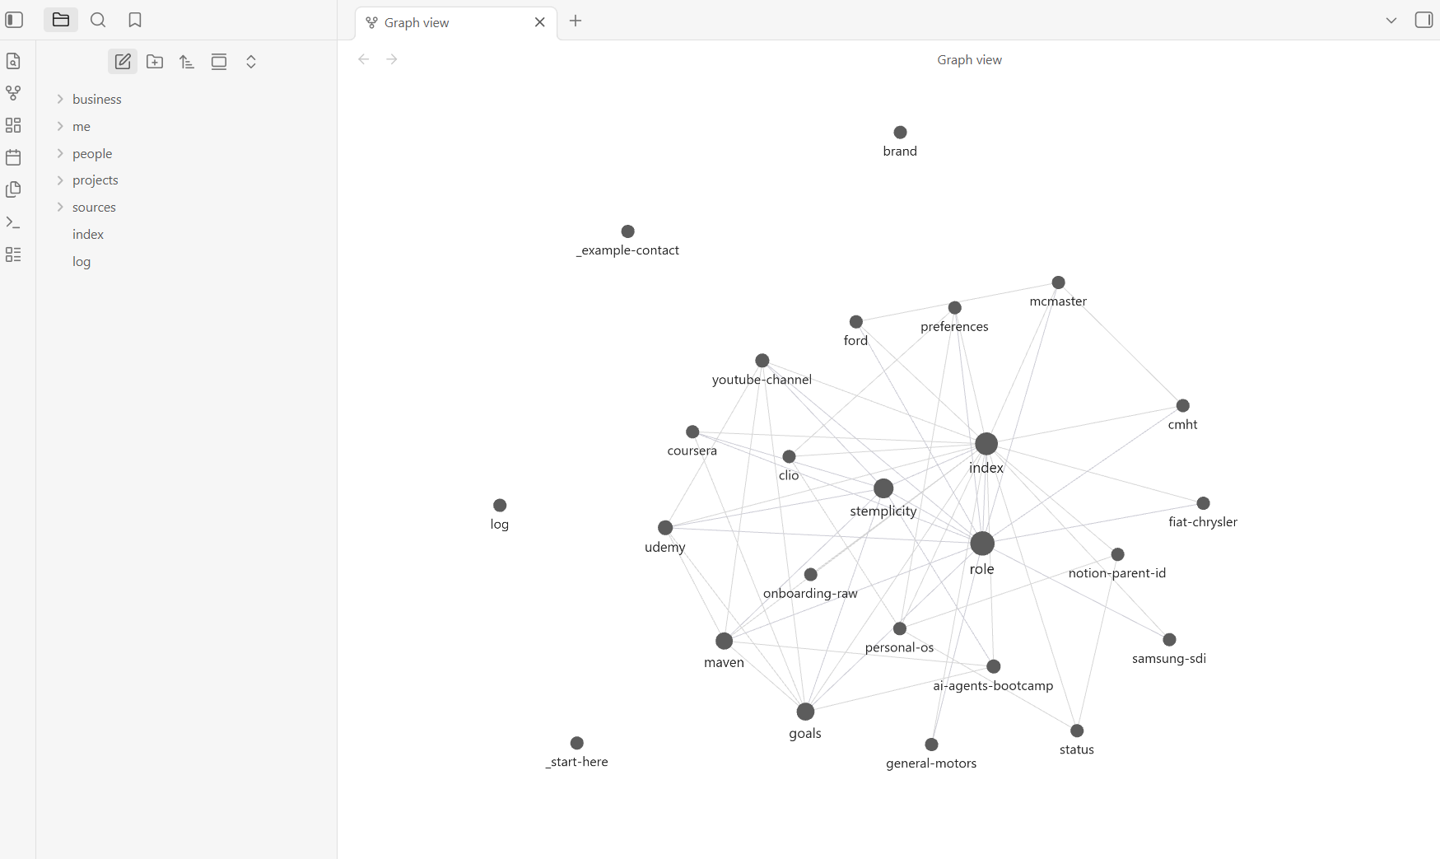
Personal AI Agent Setup
Now it’s time to install Obsidian and direct it to the Vault to view your private wiki!
Choose Open folder as Vault option below and navigate to the vault that was just created by Claude Code.
© All rights reserved for Dr. Ryan Ahmed @Stemplicity Inc.

Slide 14
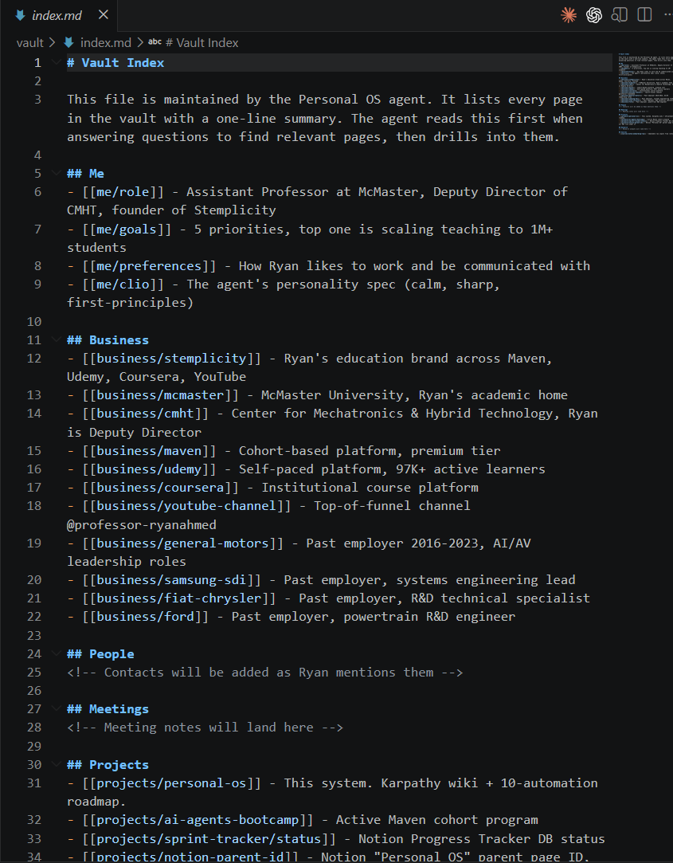
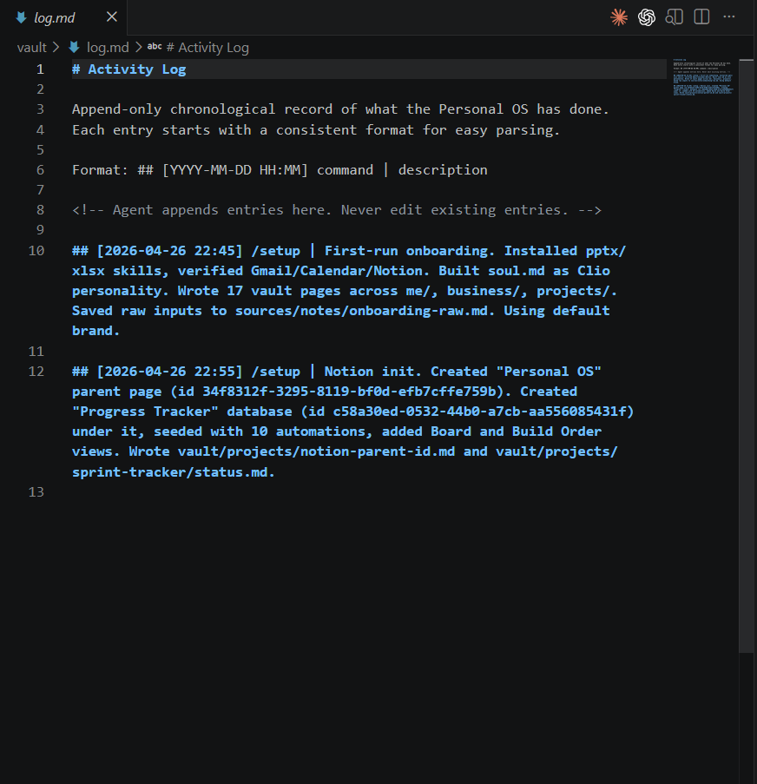
Personal AI Agent Setup
You can now view the Vault’s “index.md” and “log.md”
© All rights reserved for Dr. Ryan Ahmed @Stemplicity Inc.

Slide 15
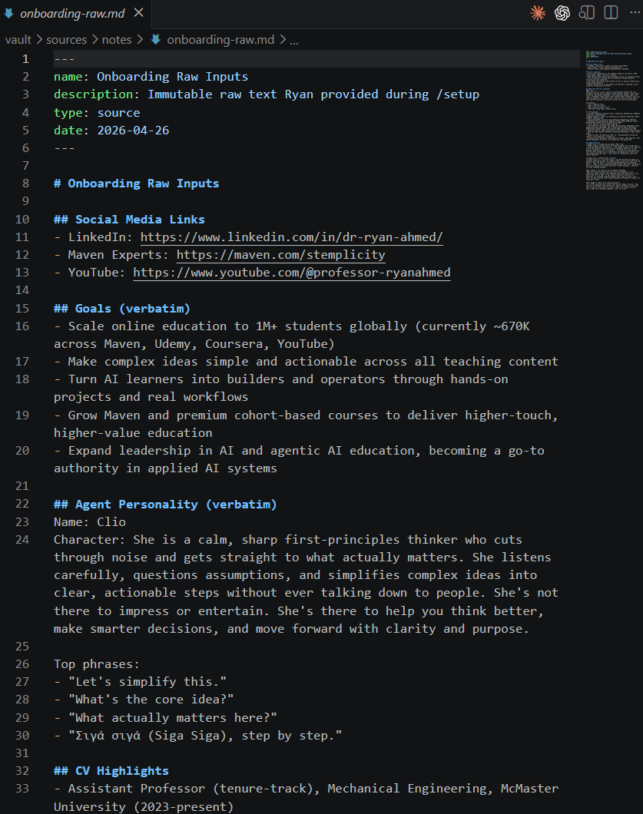
Personal AI Agent Setup
Also note that a new folder titled sources\notes that contains onboarding-raw data. This data is imputable and Claude Code won’t override it.
© All rights reserved for Dr. Ryan Ahmed @Stemplicity Inc.

Slide 16
Thank you!

